Slide 1


Slide 2

MindHaven- Track, Reflect, Heal.
Second Year Project Synopsis
Submitted by
ROLL NUMBER | NAME
2301010282 | ADEELA AZEEZ
2301010293 | ASHUTOSH SINGH
2301010298 | SATDEV
2301010315 | NEHA KUMARI
Industry Mentor: MR. RISHABH RAI
Faculty Mentor: DR. VISHWANIL SUMAN
Notes:
New Courses replaced with New Programmes

Slide 3

Project Overview
MindHaven- Track, Reflect, Heal. is a digital tool or application that allows people to log, track, and evaluate their moods over time. It helps them to journal their thoughts. It assists users in recognizing emotional triggers, comprehending their mood patterns, and taking proactive measures to enhance their mental health. Typical elements of the system include data visualization, AI-based insights, mood recording, and tailored suggestions for emotional well-being.
Notes:
New Courses replaced with New Programmes

Slide 4
About the Problem
Despite being vital to overall wellbeing, mental health is frequently disregarded because of hectic schedules, a lack of knowledge, or the shame associated with emotional difficulties. Mood monitoring has become a popular tool for tracking feelings, spotting trends, and enhancing mental health. A computer tool called a mood tracking system is intended to assist people in recording their feelings, identifying patterns, and gaining important knowledge about their mental health.
The purpose of this project is to empower individuals to take control of their emotional well-being by providing an intuitive, data-driven, and user-friendly platform for mood tracking and journaling. By recognizing emotional patterns and triggers, users can make informed decisions to improve their mental health, reduce stress, and enhance their overall quality of life
Notes:
New Courses replaced with New Programmes

Slide 5
Problem Statement
In today’s fast-paced world, mental health and emotional well-being are frequently neglected which increases stress, anxiety, and depression. Peoples find it difficult to identify patterns in their moods and emotions, which makes it challenging to manage stress, determine triggers, and seek timely interventions.
A mood tracker and journaling website can help in tracking the effectiveness of interventions, whether they're lifestyle changes, therapy, or medication. It provides a way to see if certain activities or treatments positively impact your mood over time.
Notes:
New Courses replaced with New Programmes

Slide 6
Objectives
To design and develop a scalable mood tracking website
To integrate AI-driven analytics and data visualization
To implement an intuitive and user-friendly interface
To enhance user engagement through interactive elements
To ensure data privacy and security
To conduct extensive testing and gather user feedback.
Notes:
New Courses replaced with New Programmes

Slide 7
Methodology, Tools, and Techniques
Requirement Analysis – Identify project goals, features, and user needs.
Planning – Define technology stack, architecture, and development roadmap.
UI/UX Design – Create wireframes and prototypes using Figma.
Front-end Development – Develop the user interface with React.js or Vue.js.
Back-end Development – Build the server-side logic using Node.js/Django/Flask.
Database Setup – Configure PostgreSQL or MongoDB for data storage.
AI Integration – Implement chatbot functionality with OpenAI API or Rasa.
Security Implementation – Integrate OAuth, SSL, and GDPR compliance.
Testing & Debugging – Conduct unit, integration, and security testing.
Deployment – Host on AWS, Firebase, or Vercel.
Maintenance & Updates – Monitor performance, fix bugs, and release updates.
Notes:
New Courses replaced with New Programmes

Slide 8
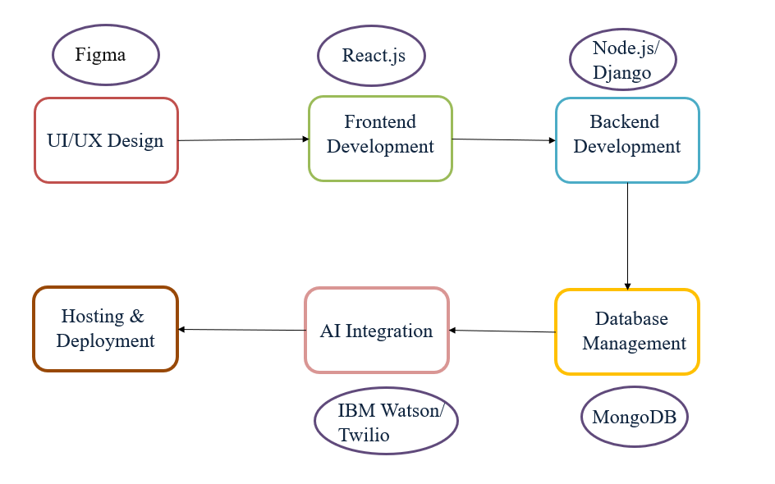
Methodology Flowchart
Notes:
New Courses replaced with New Programmes

Slide 9
Project Timeline
Research Analysis
Planning and Designing
Frontend Development
1 Feb 2025 to 7 Feb 2025
8 Feb 2025 to 14 Feb 2025
14 Feb 2025 to 28 Feb 2025
AI Integration
Database Setup
Backend Development
1 April 2025 to 7 April 2025
16 March 2025 to 31 March 2025
1 March to 15 March 2025
Testing and Debugging
Hosting and Deployment
8 April 2025 to 20 April 2025
21 April 2025 to 30 April 2025
Notes:
New Courses replaced with New Programmes

Slide 10
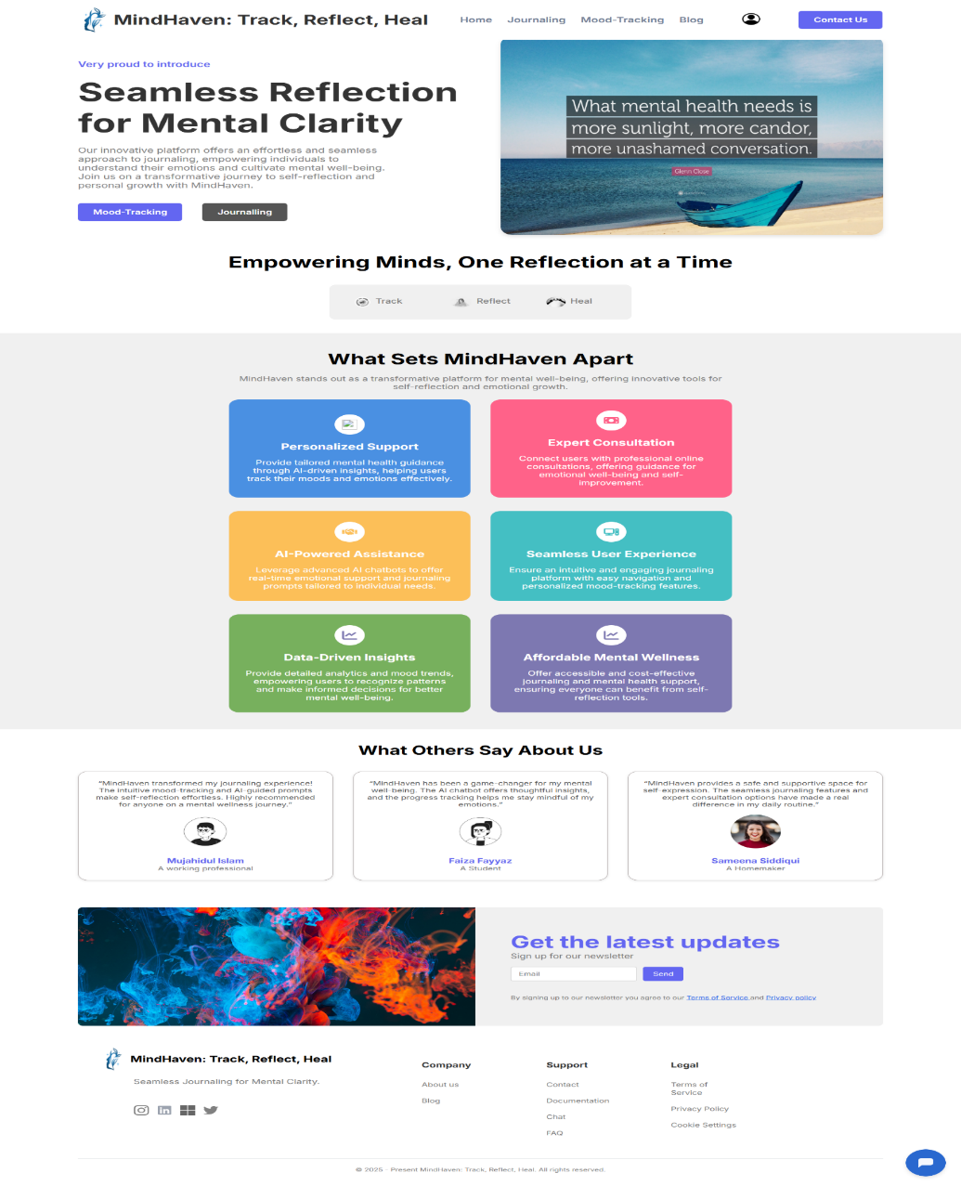
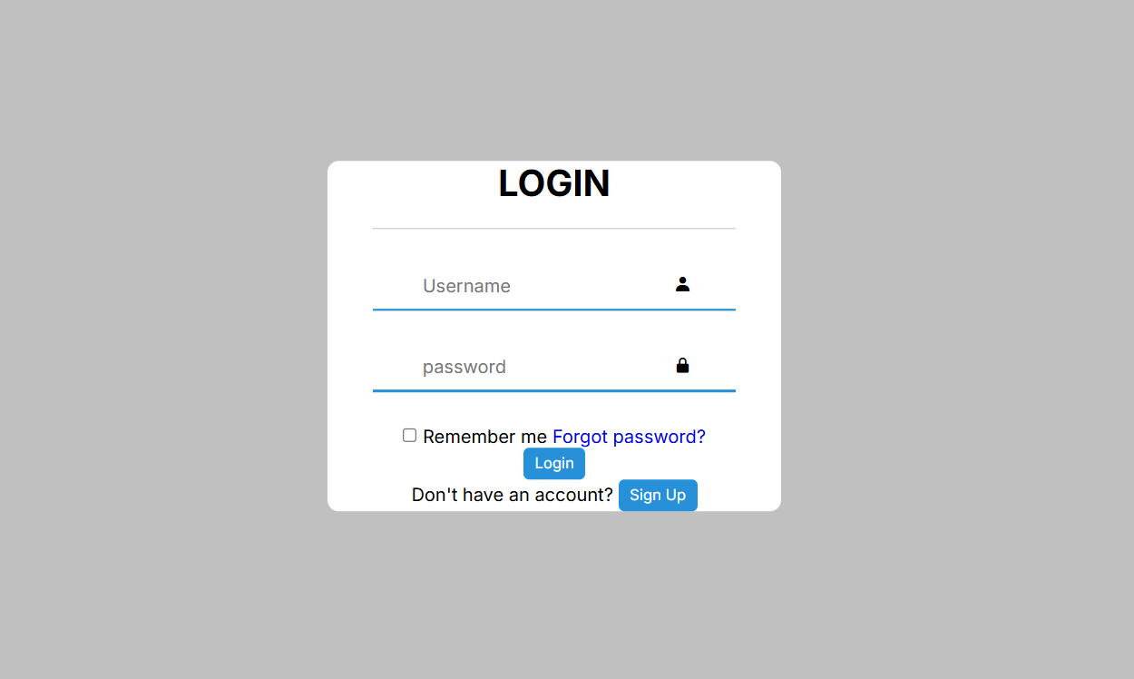
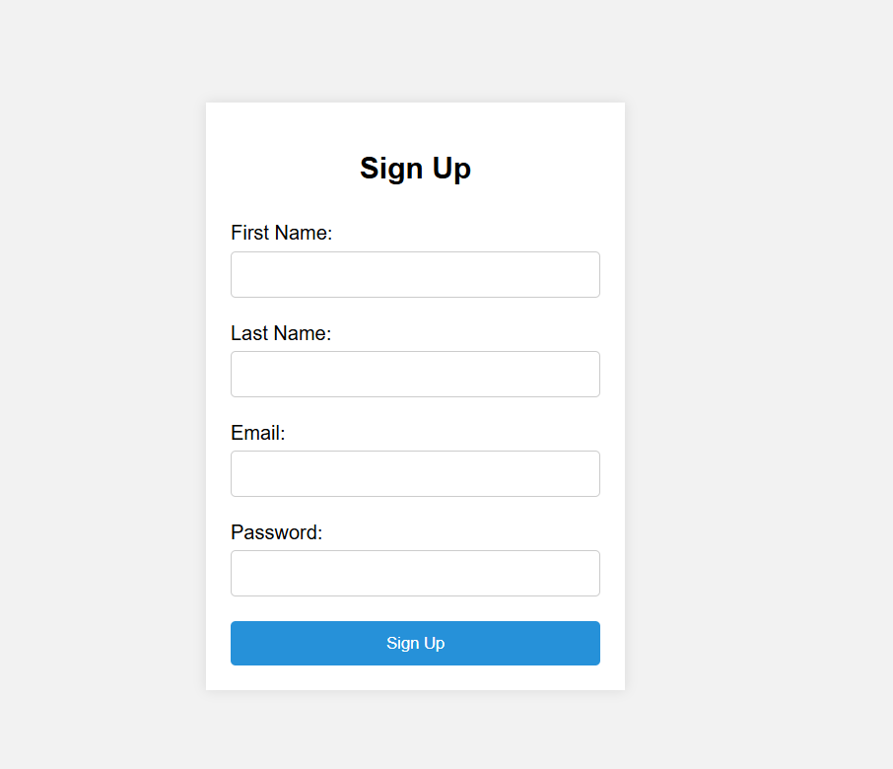
FEW GLIMPSES OF OUR WEBSITE

Slide 11
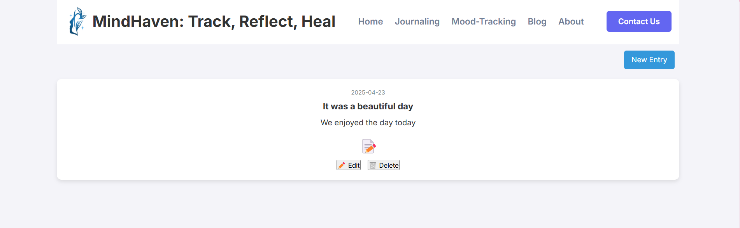
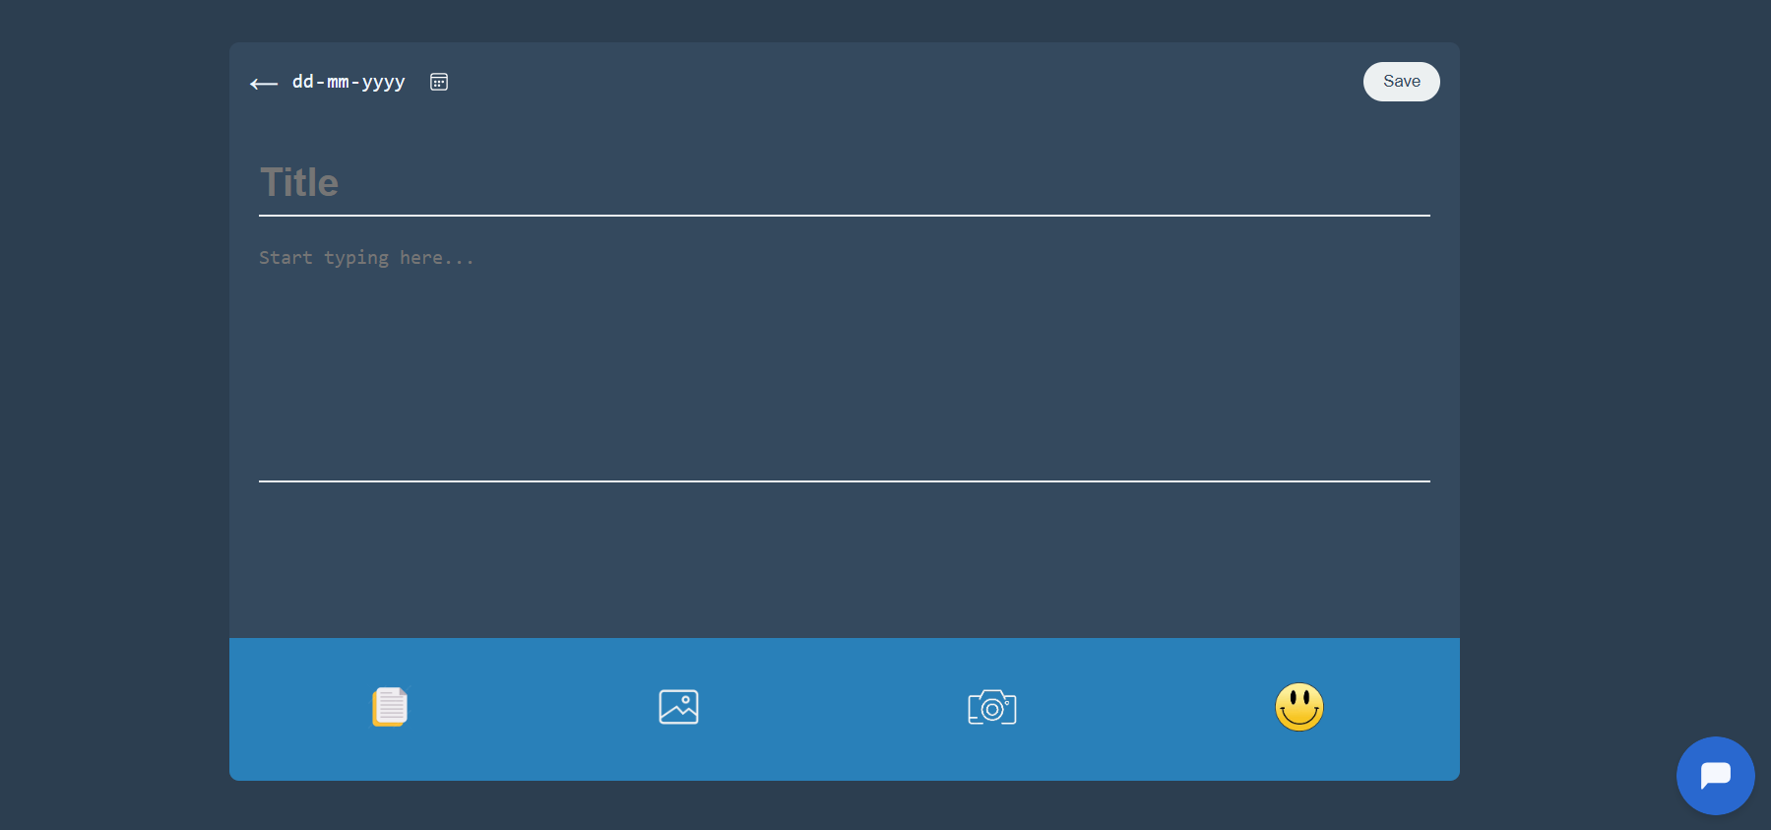
FEW GLIMPSES OF OUR WEBSITE

Slide 12
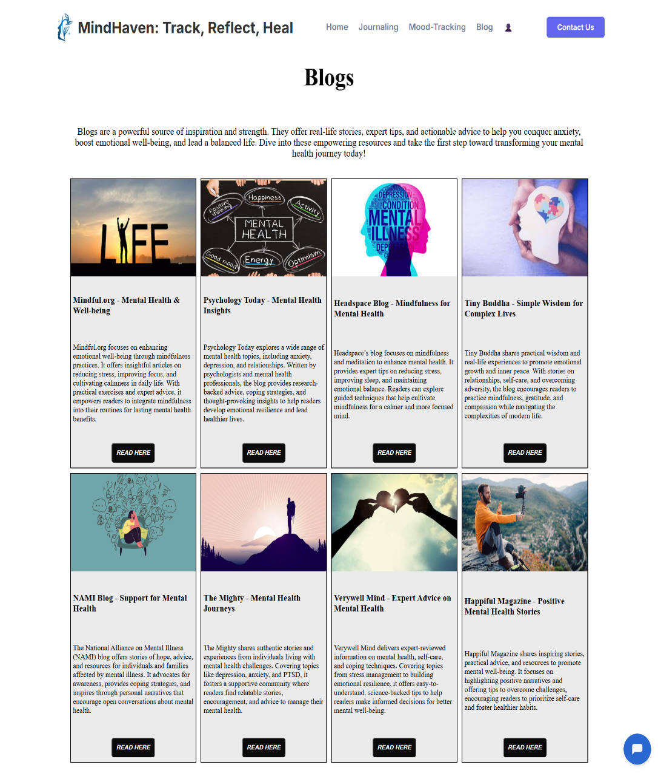
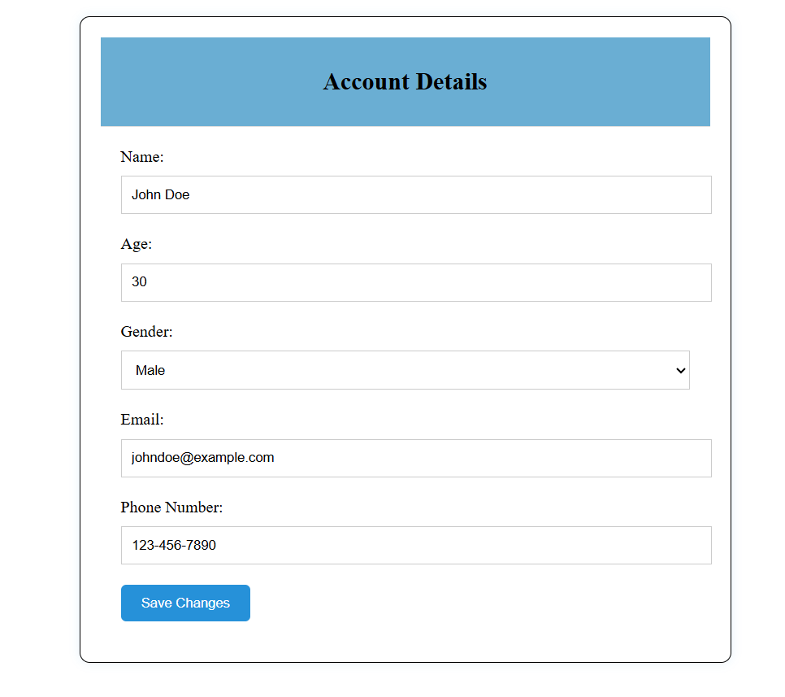
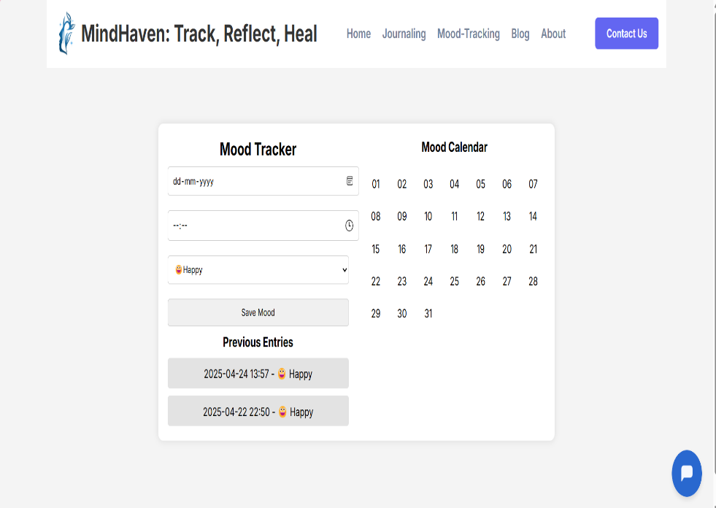
FEW GLIMPSES OF OUR WEBSITE

Slide 13
Expected Results & Impact
Expected Results:
Improved Emotional Awareness & Self-Reflection
Better Stress & Anxiety Management
Increased Accessibility to Mental Health Support
Reduced Stigma Around Mental Health
Impacts:
Enhances accessibility and engagement in digital mental health solutions.
Contributes to the development of adaptive AI in mental wellness.
Increased Accessibility to mental health support
Expansion by integration with therapy & counseling Services
Notes:
New Courses replaced with New Programmes

Slide 14
References
Baikie, K. A., & Wilhelm, K. (2020). Emotional and physical health benefits of expressive writing. Advances in Psychiatric Treatment, 11(5), 338-346.
Bennion, M. R., Hardy, G., Moore, R. K., & Millings, A. (2020). E-therapies in England for mental health problems: An updated systematic review. Journal of Medical Internet Research, 22(7), e15641.
Fitzpatrick, K. K., Darcy, A., & Vierhile, M. (2017). Delivering cognitive behavior therapy to young adults with symptoms of depression and anxiety using a fully automated conversational agent. JMIR Mental Health, 4(2), e19.
Hollis, C., Falconer, C. J., Martin, J. L., Whittington, C., Stockton, S., Glazebrook, C., & Davies, E. B. (2018). Annual research review: Digital health interventions for children and young people with mental health problems–a systematic and meta-review. Journal of Child Psychology and Psychiatry, 59(4), 415-435.
Notes:
New Courses replaced with New Programmes

Slide 15
THANK YOU

